Slide 1
ON-CAMPUS WRITING LAB (OWL)​
​ hdenny@purdue.edu​ writing.lab@purdue.edu​ owl.purdue.edu​

Slide 2
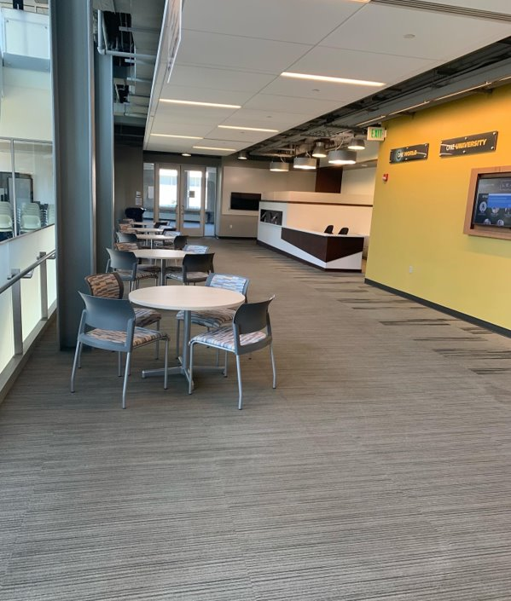
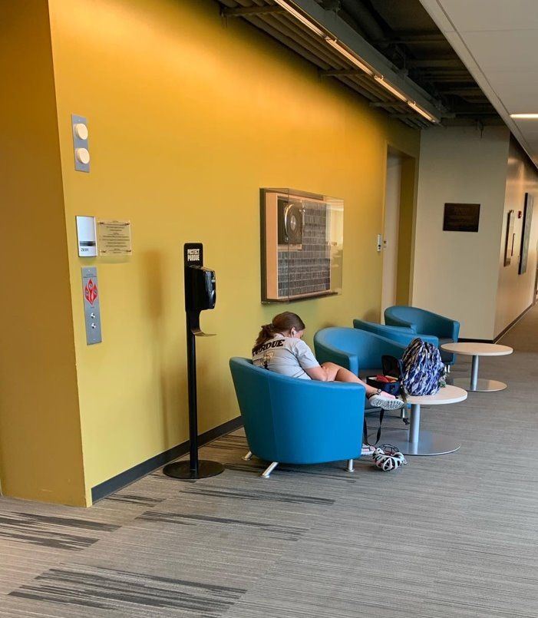
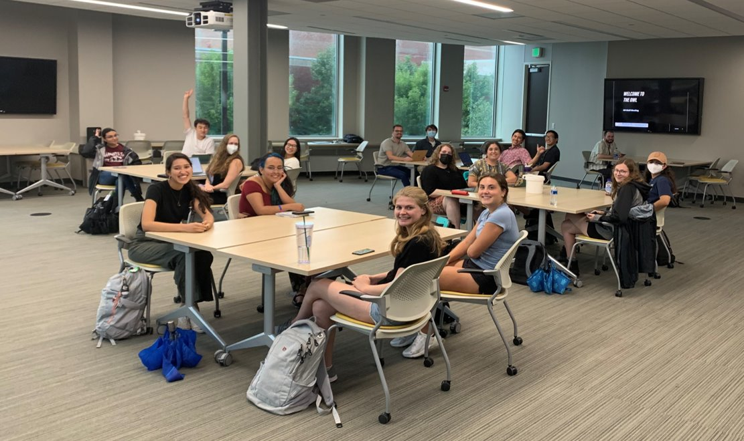
On-Campus Writing Lab (OWL)
Overview
Support all campus writers, for all courses and needs, at any point in their career.
Webpage support (owl.purdue.edu)
1.1 m to 4 million unique users/week

Slide 3
On-Campus Writing Lab (OWL)
How we work
Ways of meeting students
Face-to-face in our locations
Online chats
Upload a document for feedback
Support we provide
One-to-one & small group writing support
Workshops – General and collaborations with faculty
Conversation groups
For faculty & graduate students: Intensive Writing Experiences (IWEs), Writers’ Rooms

Slide 4
On-Campus Writing Lab (OWL)
How to support?
Build student writers.
Foster a writing culture (everyone writes, everyone needs support).
Share your own experiences getting help with writing.
Workshop writing assignments or documents with us & share your syllabi with us.
Encourage student visits in productive ways.
Require visits in meaningful & sustainable ways.
Avoid penalty box mindset (all writers can benefit from feedback).
Build our staff.
Help us recruit students who are strong writers AND who have good people skills (listeners, empathetic).
Nurture desire of some graduate students to experience learning pedagogy and leadership.

Slide 5
On-Campus Writing lab (owl)
One more time…
hdenny@purdue.edu​ writing.lab@purdue.edu​ owl.purdue.edu

Slide 6
Oral English Proficiency Program (OEPP)
Mark Haugen
Email: mhaugen@purdue.edu
OEPP@purdue.edu

Slide 7
OEPP: An Overview
The OEPP supports international graduate student language development.
For current and prospective teaching assistants
Four Core Program Elements
Oral English Proficiency Testing
Instruction: Classroom Communication in ESL for International Teaching Assistants
Verify TAs are Certified for Oral English
Volunteer Program and Certificate

Slide 8
OEPP: Services We Provide
Testing
For prospective international student TAs who do not meet the automatic certification requirements (e.g., 27 on the TOEFL speaking).
Offered monthly during the academic year; weekly in the summer.
We tested 614 students in 2021-22.
Instruction: Classroom Communication in ESL for International Teaching Assistants
Students receive one-on-one tutoring.
Interact with undergraduate students in 5 teaching presentations.
171 students in 2021-22.
Volunteer Program
Volunteers observe, participate, and prepare written feedback.
1048 unique volunteers; 1935 hours of volunteering in 2021-22.
Intercultural Communication Partner Certificate for 10 hours of volunteering.

Slide 9
OEPP: Additional Support/Opportunities
Standardized Test Score Interpretation
TOEFL, IELTS, Duolingo
Feedback on Student Performance on the OEPT
One-on-One Tutoring
Undergraduate Student Volunteers
Encourage your undergraduate students to volunteer
Contact: Mark Haugen: mhaugen@purdue.edu
OEPP@purdue.edu
More information: https://www.purdue.edu/oepp/

Slide 10
Purdue language and cultural Exchange (place)
Director: Matthew Allen
Email: mcallen@purdue.edu
place@purdue.edu

Slide 11
PLaCE: Program Overview
Notes:
This slide gives a big picture overview of the PLaCE program:
Mission and Goals: PLaCE promotes internationalization at Purdue. Purdue attracts many international students, and we see language and cultural differences as opportunities to enrich and enhance the quality of a Purdue degree for all students, Our specific mission is to help international students advance their English language proficiency and intercultural competence so that they can take full advantage of the educational opportunities available at Purdue. PLaCE has enrolled over 9,000 students from across the university in English language courses since the program started in August 2014.
Foundational Course Sequence of English 110 and 111
(see next slide)
Short Courses on Specific Language Skills
(see next slide)
Outreach and Support for English Language Issues on Campus
Because of our expertise and experience with English language learning and international students, PLaCE works with members of the campus community, including consulting on issues related to English as a second language, adaptation for international students to the U.S., and presentations and workshops for student groups about PLaCE classes and on topics related to language and culture. PLaCE staff have worked with faculty and students in the Purdue Polytechnic, Statistics, Philosophy, and Engineering.
English Language Institutes and International Partnerships
PLaCE develops and delivers revenue-generating English language institutes and summer programs in conjunction with campus partners, including the Department of Philosophy, Colombia Purdue Initiative, and Global Engineering Programs. Members of PLaCE staff have also worked in Haiti and Colombia on projects related to English-language teaching, learning, and assessment.
Program Evaluation of Evaluation and Assessment of Learning
PLaCE conducts ongoing evaluation on the effectiveness of learning and teaching within the program. One of our major instruments is the ACE-In. The Assessment of College English–International (ACE-In) is an Internet-based, post-admission test of English proficiency for international English as a Second Language (ESL) undergraduate students at Purdue University.

Slide 12
PLaCE Courses
ENGL 110 and 111: Two-semester sequence of courses for incoming international undergraduates with qualifying English language proficiency test scores. Offered each semester and in summer.
Short Courses: 6-week, non-credit options open to all international students on specific language areas, including Academic Writing, Presentation Skills, Conversation and Discussion, Reading, and Vocabulary.
place@purdue.edu www.purdue.edu/place
Notes:
English 110 and English 111, “American Language and Culture for International Students I & II,” are designed for students who were educated outside of U.S. school systems and who learned English as a second or foreign language. In these courses, students build a strong foundation of university-level language, communication, and intercultural knowledge and skills, as well as academic thinking and learning skills, so that they can fully participate in the life of the university. The courses provide a balanced, developmental approach to learning by integrating a range of topics and activities into an engaging curriculum focused on academic skills, language skills, and intercultural competence.
English 110 is approved to meet the foundational learning outcomes for Human Cultures: Humanities (HUM).
Enrollment: PLaCE identifies matriculated international undergraduate students who will benefit from additional English language support, based on their English language proficiency scores for admission (i.e., TOEFL iBT Total score of 100 or less, IELTS Overall score of 7.5 or less, or DET score of 125 or less) and enrolls these students in ENGL 110 and ENGL 111 as a prerequisite for Written Communication courses (e.g., ENGL 106 INTL, ENGL 106, SCLA 101).
Average number of new admits each fall: 462 students
Top enrollment by college: Engineering, Science, Polytechnic, Liberal Arts, Exploratory Studies
Short Courses—Six-week, non-credit classes open to all international students for specific language skills. Primary audience is graduate students, to give them targeted instruction and scheduling flexibility. We offer a "menu" of courses that can be taken a la carte and can be repeated. We encourage students to consult with their advisor to avoid conflicts. SCs complement other services/programming on campus (OEPP, Writing Lab, Graduate School).

