Slide 1
Verbal Classifiers, Numerals, & Telicity in Mandarin:
An Exo-Skeletal Analysis
Pin-Hsi Chen
Purdue University
(Indigenous and Endangered Languages Lab)

Slide 2
Main Questions
What is the relation between verbal classifier, numeral, and telicity in Mandarin?
How do we represent this relation formally?
Ta (zai san miao nei) qiao zhuo-zi liang xia.
3rd (be-at three second inside) knock table two CLv-TIME
“S/he knocked the table twice (in three seconds).”
Notes:
VP followed by Numeral Classifier, meaning knocking two times consecutively

Slide 3
Outline
What is telicity and where does it come from?
What are the functions of a verbal classifier?
The Exo-Skeletal Model (Borer, 2005)
Applying the model to verbal classifier construction
Empirical evidence
Conclusions

Slide 4
Telicity (Quantity Event)
X is quantity if X is non-cumulative or non-divisive.
“a cup of water” => quantity
“water” => non-quantity
“The bird flew to the tree top.” => quantity (telic)
“The bird flew.” => non-quantity (atelic)

Slide 5
Telicity (Quantity Event)
Telic events are compatible with “in X time.” Atelic events are compatible with “for X time.”
“The bird flew to the tree top in five minutes / *for five minutes.”
“The bird flew for five minutes / *in five minutes.”

Slide 6
Where does telicity come from?
A quantity object (Verkuyl’s Generalization) (Verkuyl, 1972):
“I drank a cup of water in five minutes.”
A verb or preposition that denotes an endpoint (Chen et al., in press):
“The bird flew to the tree top in five minutes.”
A numeral or quantifier:
“He blinked three times in five seconds.”

Slide 7
Functions of Verbal Classifiers
Divide an event into countable sub-events.
License a numeral that counts the number of sub-events.
The numeral in turn gives rise to a telic interpretation.
Ta (zai san miao nei) qiao zhuo-zi liang xia.
3rd (be-at three second inside) knock table two CLv-TIME
“S/he knocked the table twice (in three seconds).”

Slide 8
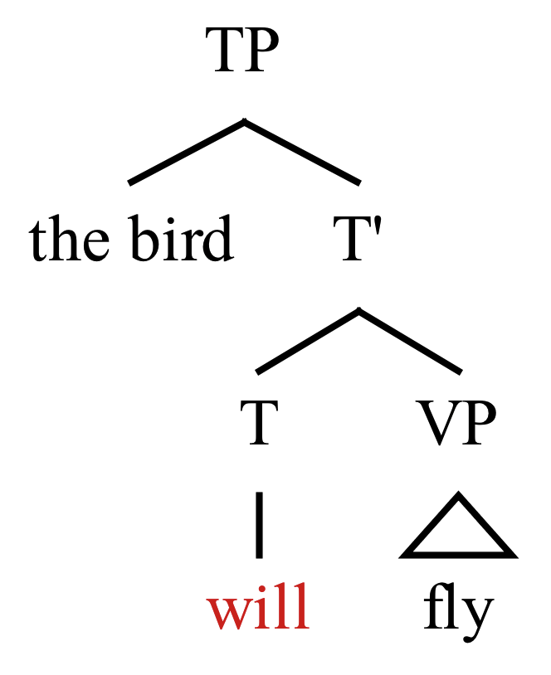
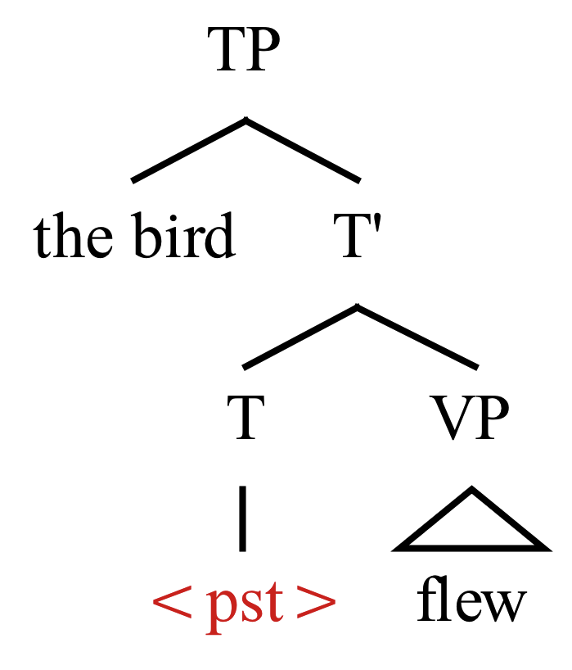
The Exo-Skeletal Model (Borer, 2005)
Functional projections (TP, DP, AspP, QP, etc.) have empty heads.
Certain linguistic elements can provide semantic content (assign range) to an empty head. They can be a morpheme, phrase, or feature.
Notes:
In technical terms we say these elements assign range to the empty head
The elements that assign range don’t have to be in the head position, it could also be in the specifier.

Slide 9
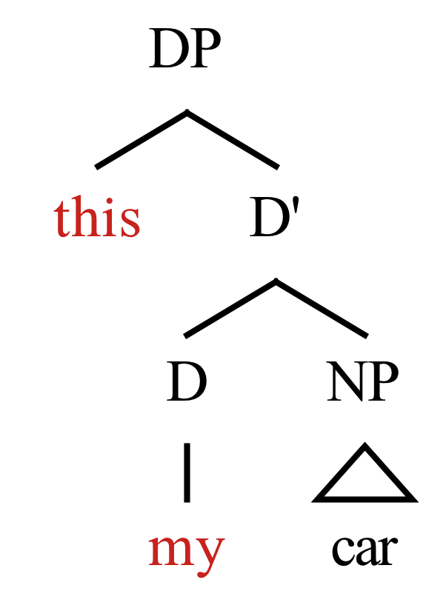
The Exo-Skeletal Model
3) One empty head cannot be assigned range by more than one element at the same time.
* “this my car”

Slide 10
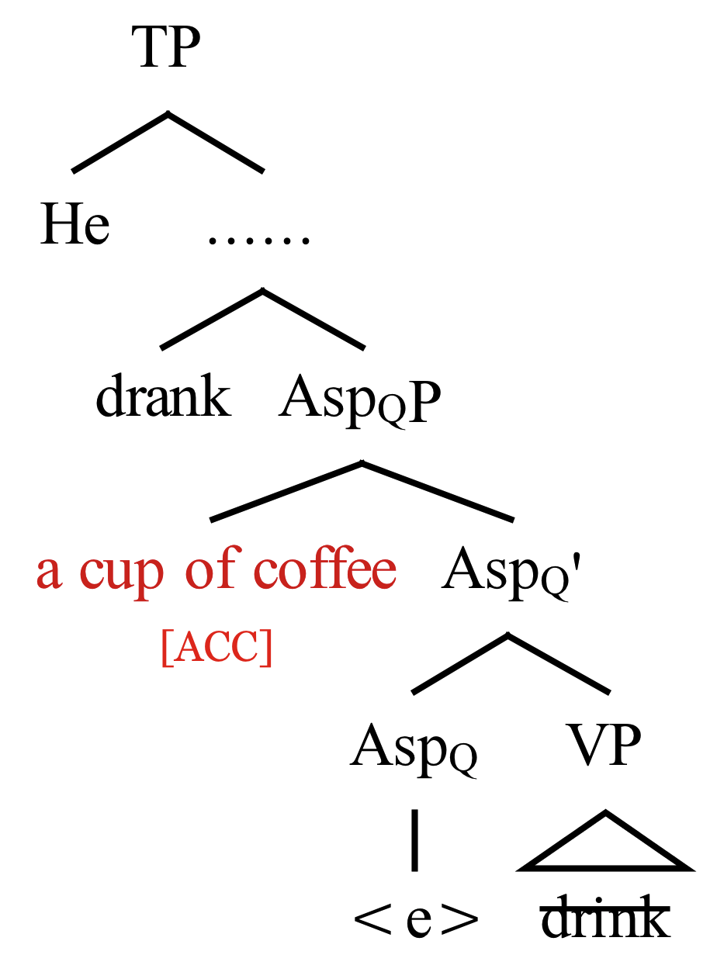
The Exo-Skeletal Model
4) Asp_{Q}P is the functional projection responsible for telicity. It also assigns accusative case to an object (Borer, 2005b).
Notes:
Range is assigned by the quantity object

Slide 11
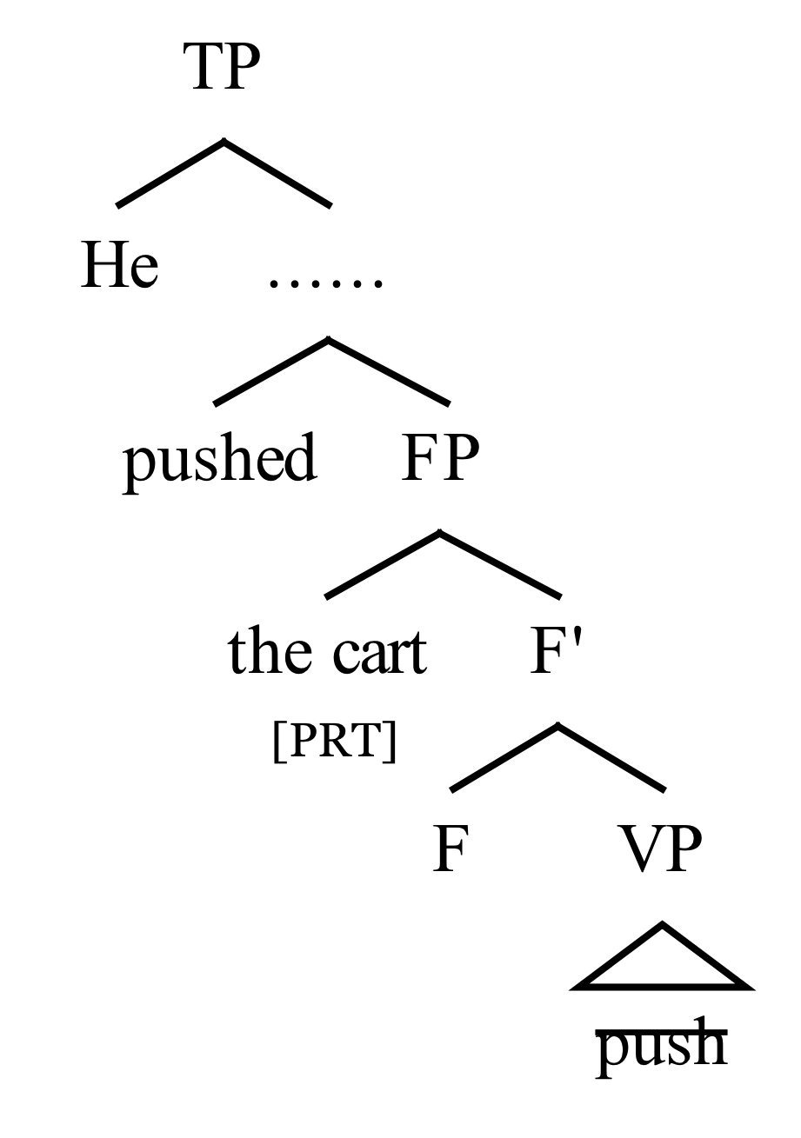
The Exo-Skeletal Model
5) If an event is atelic, there is no Asp_{Q}P. Instead, the object is introduced by a functional projection that assigns partitive case (Borer, 2005b).

Slide 12
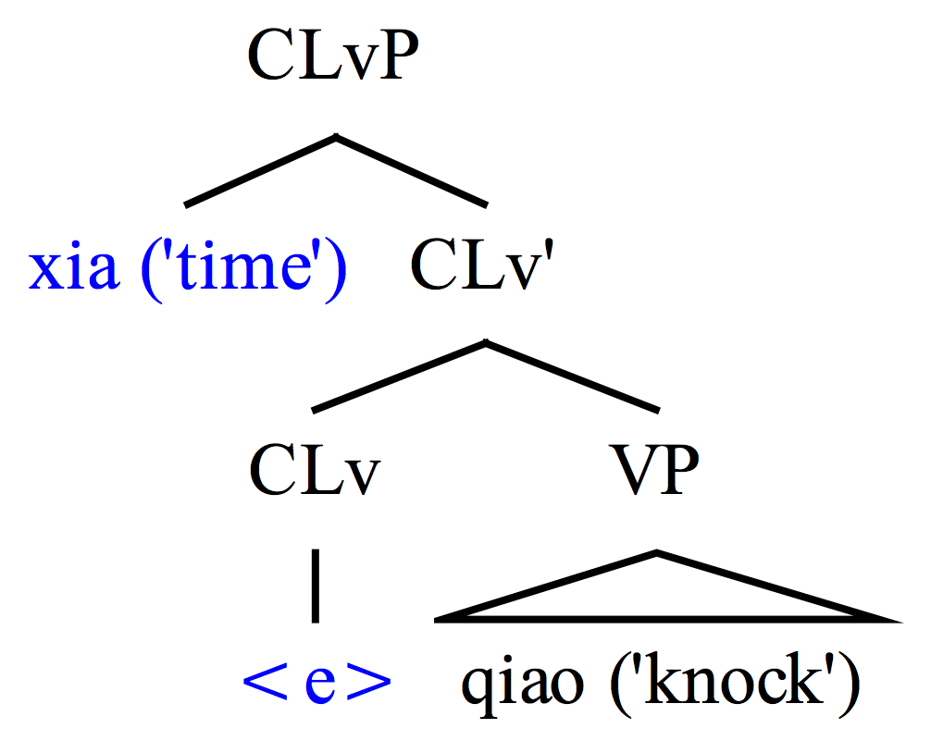
Applying the Model
A verbal classifier phrase (CLvP) projects, assigned range by a verbal classifier.
Qiao xia
Knock CLv-TIME
“Knock time”

Slide 13
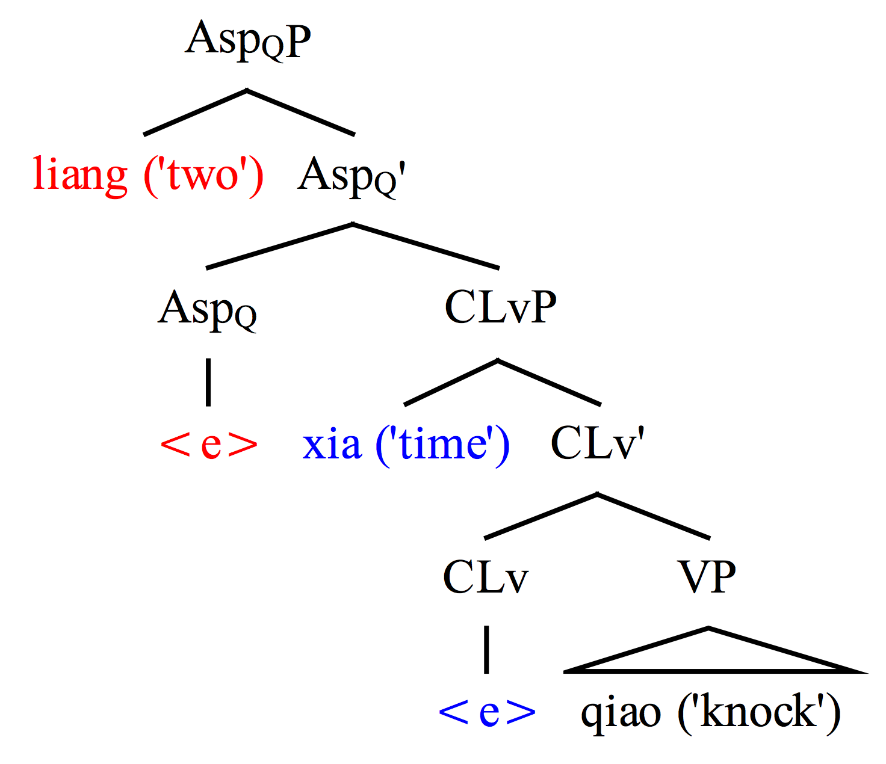
Applying the Model
2) A numeral counts the sub-events and assigns range to Asp_{Q}.
Qiao liang xia
Knock two CLv-TIME
“Knock two times”

Slide 14
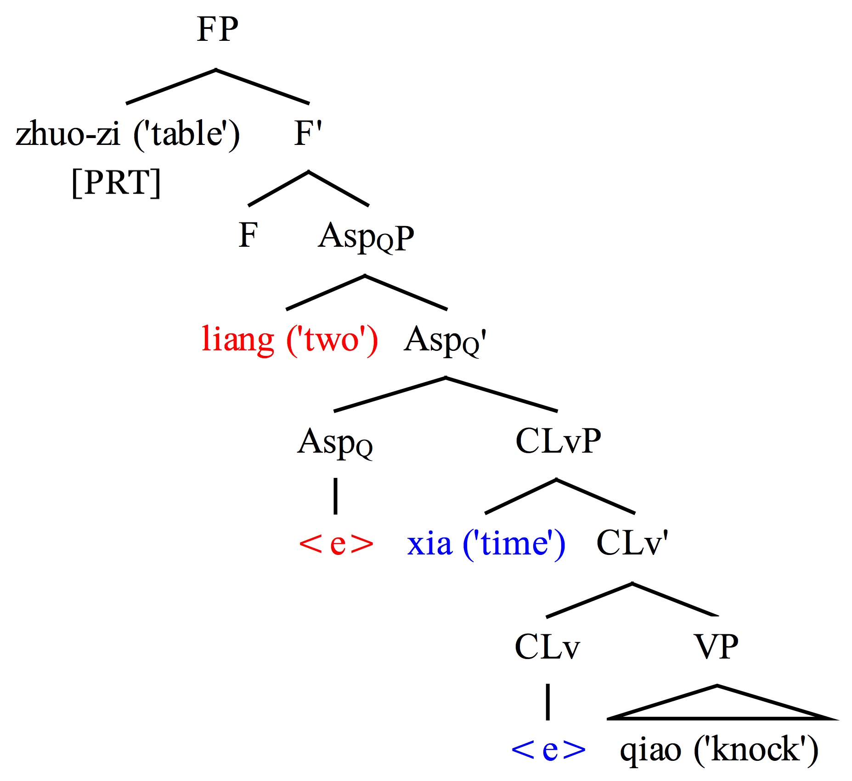
Applying the Model
3) If there is an object, it is introduced by FP.
Qiao zhuo-zi liang xia
Knock tabel two CLv-TIME
“Knock the table two times”

Slide 15
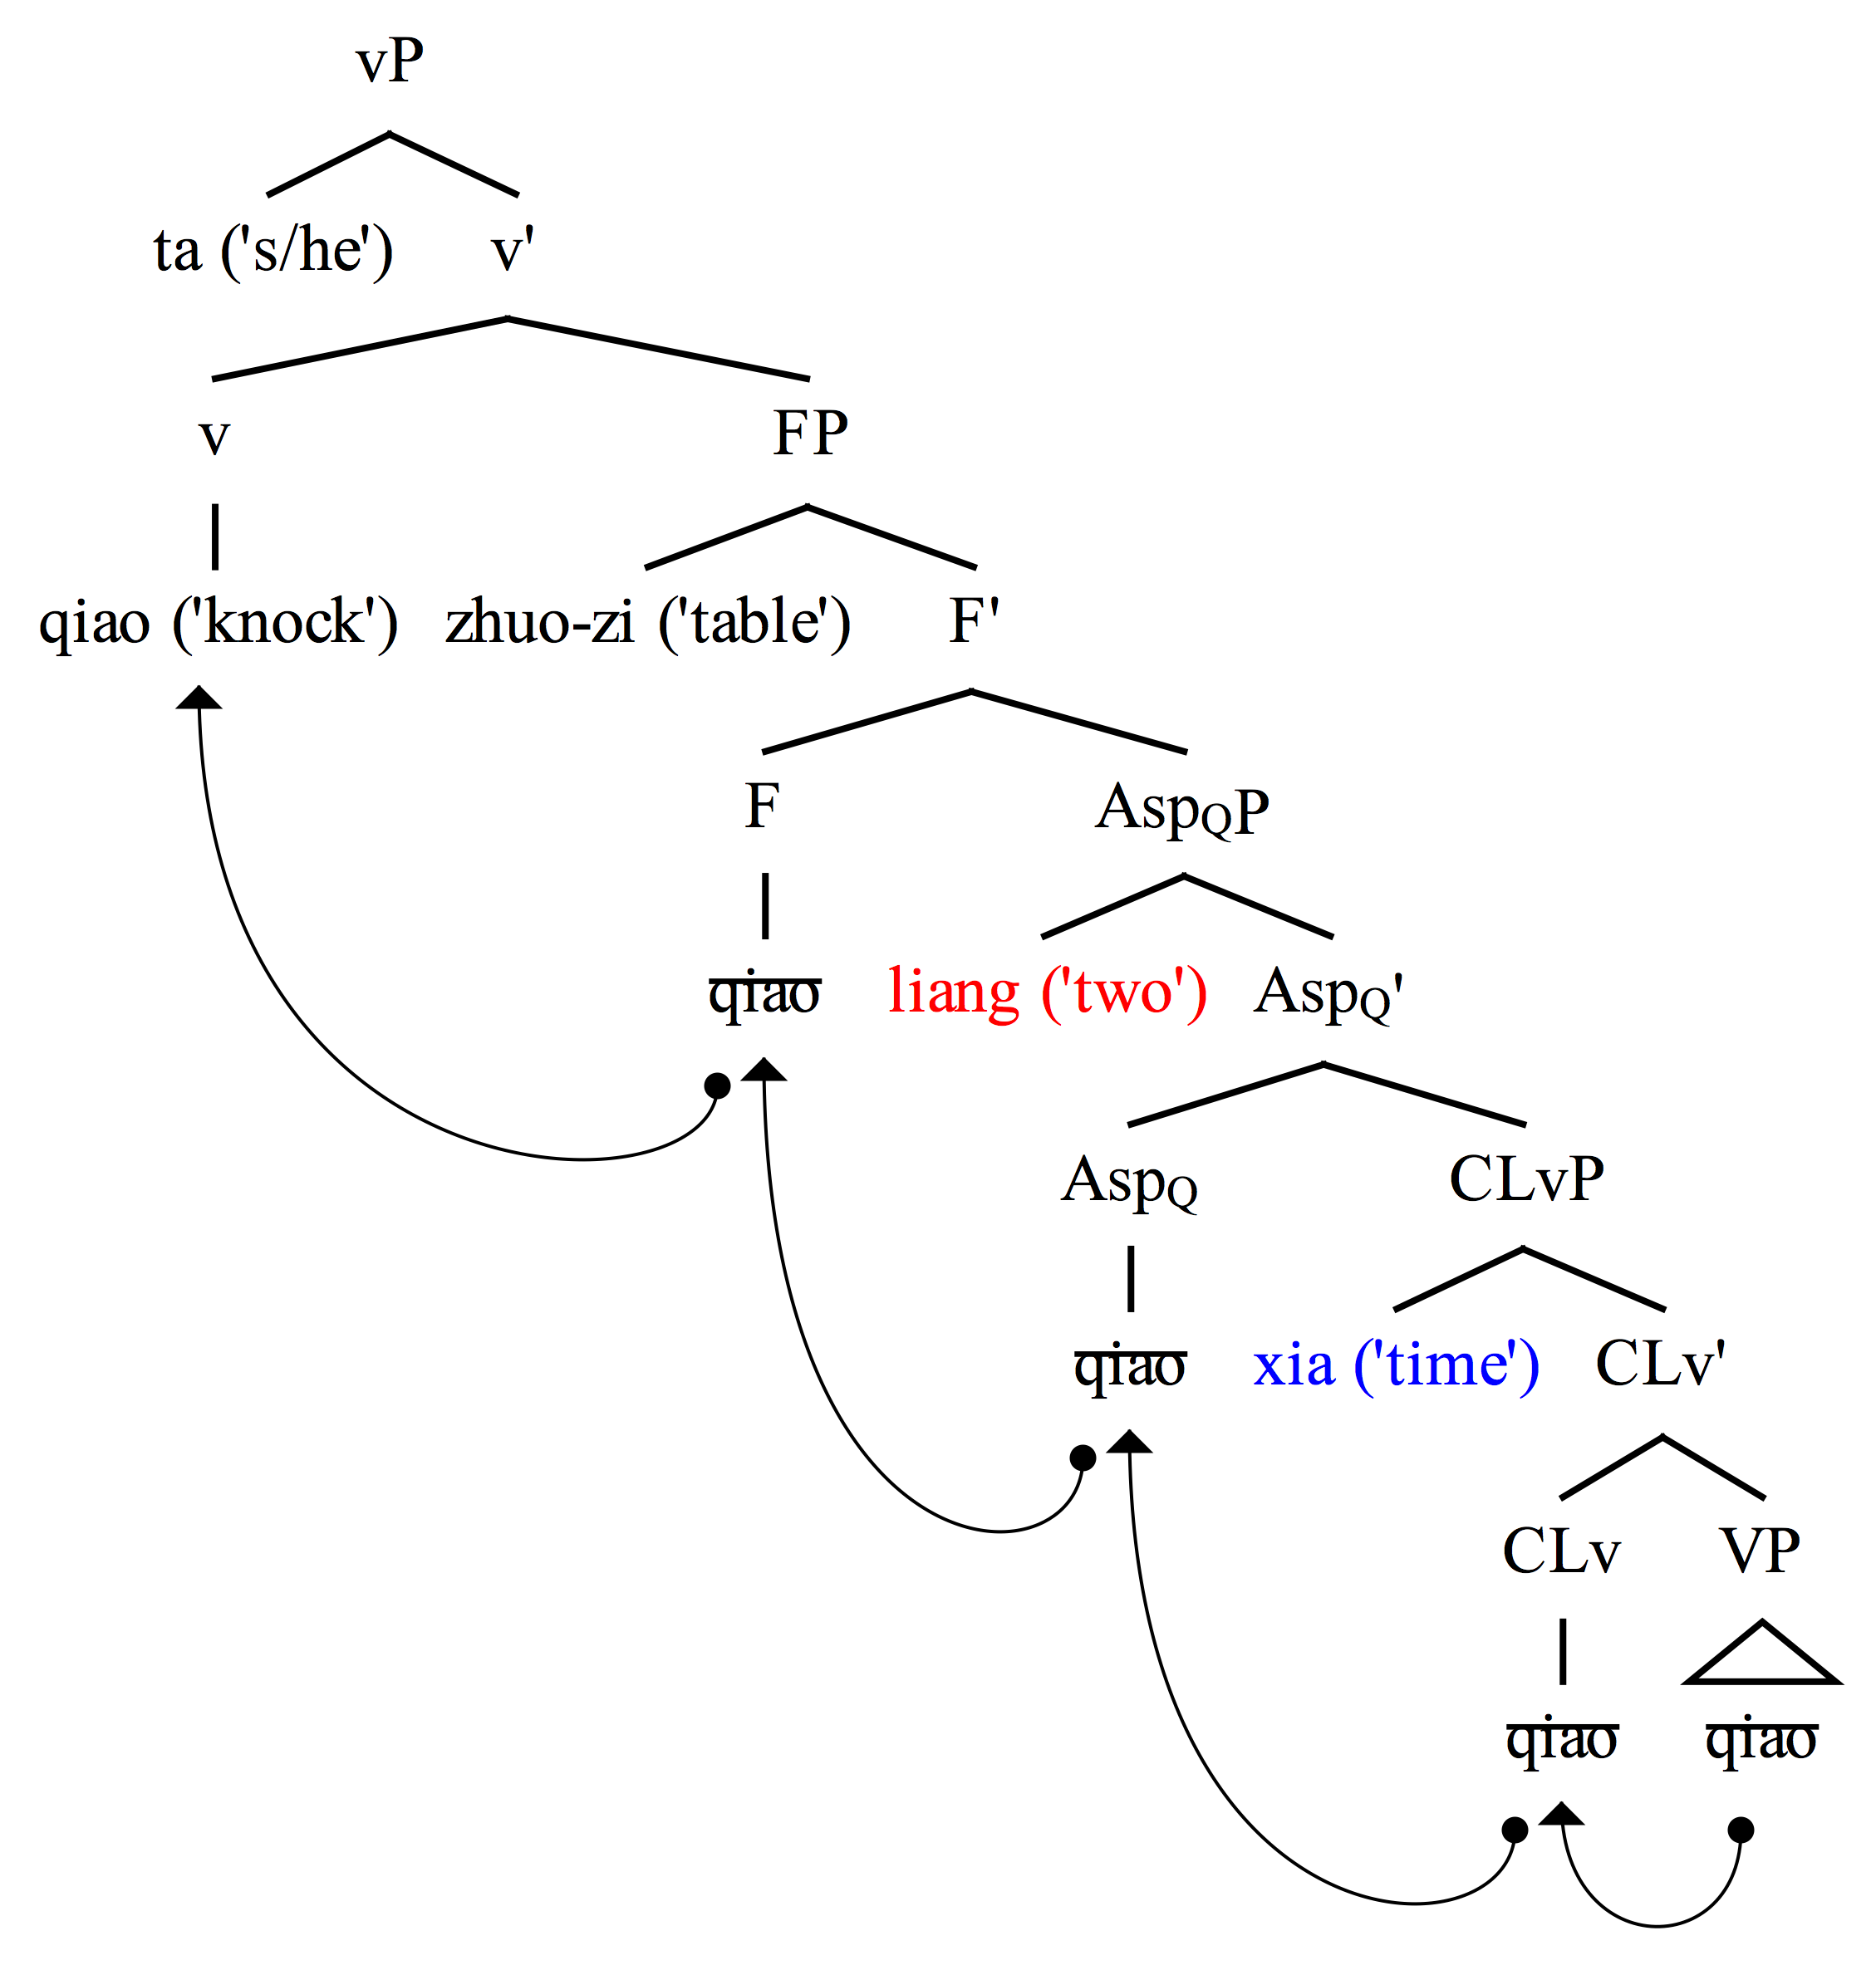
Applying the Model
4) Additional layers…
Ta. qiao zhuo-zi liang xia
3rd. knock table two CLv-TIME
“S/he knocks the table two times”

Slide 16
Empirical Evidence - Absence of Quantity Object
Telicity does not come from a quantity object in verbal classifier construction.
i) Ta zai san miao nei qiao *(liang xia).
3rd be-at three second inside knock two CLv-TIME
“S/he knocked twice in three seconds.”
ii) Ta zai san miao nei xiao *(liang sheng.)
3rd be-at three second inside laugh two CLv-SOUND
“S/he laughed twice in three seconds.”
Notes:
I have claimed that telicity in verbal classifier construction comes from a numeral
Take out numeral, it won’t be compatible with in x time

Slide 17
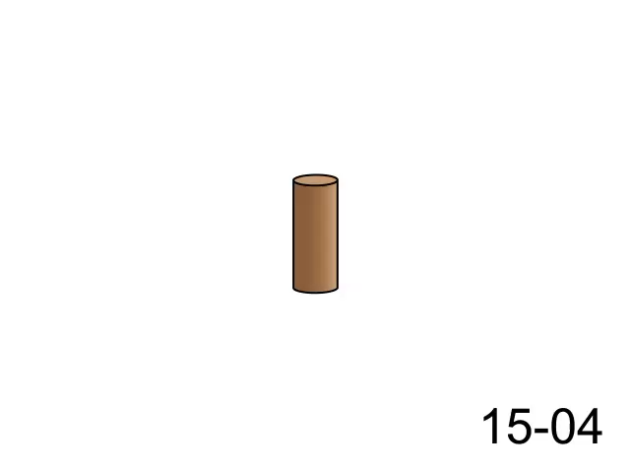
Empirical Evidence - Motion Predicates

Slide 18
Empirical Evidence - Motion Predicates
(i) Mu-zhuang bei qiao dao fang-kuai li.
wood-peg BEI hammer arrive cube inside
“The wooden peg was hammered into the cube.”
(ii) Mu-zhuang bei qiao si xia.
wood-peg BEI hammer four CL-TIME
“The wooden peg was hammered four times (in a row).”
(iii) *Mu-zhuang bei qiao si xia dao fang-kuai li.
Wood-peg BEI hammer four CL-TIME arrive cube inside
“The wooden peg was hammered four times (in a row) into the cube.”
Notes:
Recall in motion predicates “reach” assigns range to AspQ
Recall that can’t have two elements assigning range to the same head at the same time

Slide 19
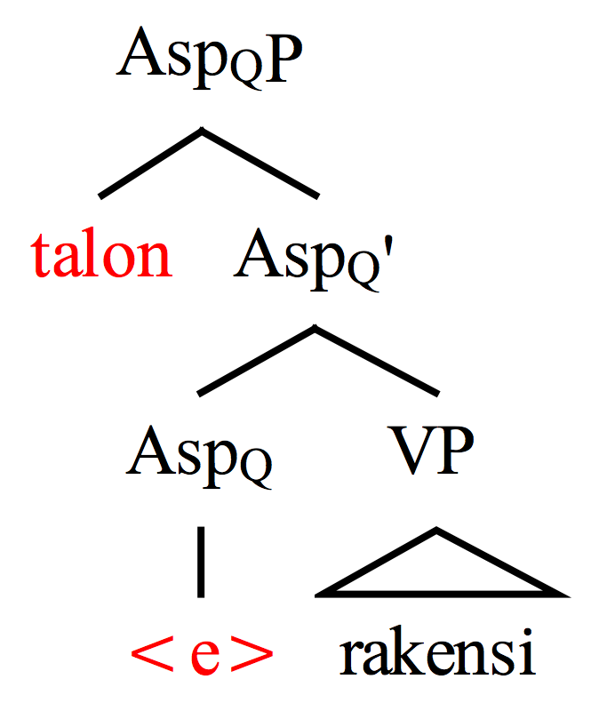
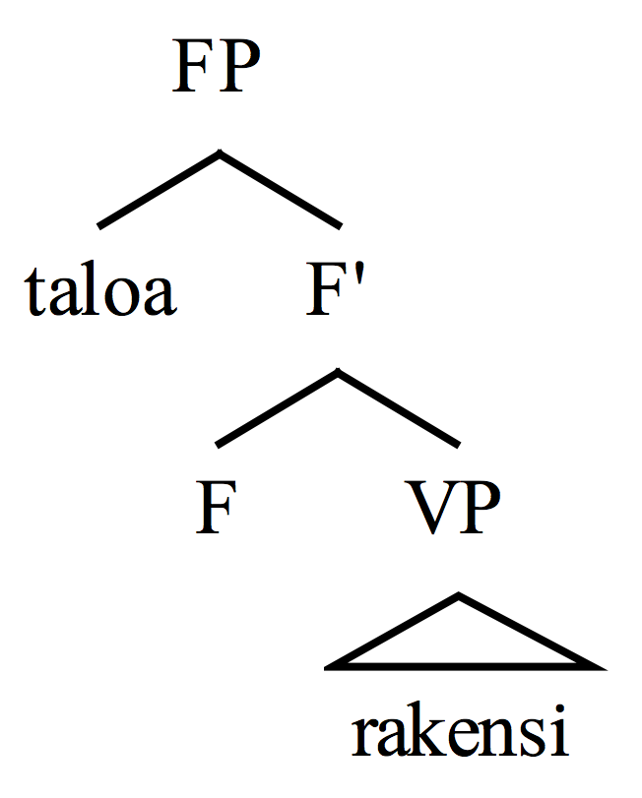
Empirical Evidence - Finnish
(i) Anne rakensi talon.
Anne built house-ACC
“Anne built a/the house.” (telic)
(i) Anne rakensi taloa.
Anne built house-PRT
“Anne was building a/the house.” (atelic)

Slide 20
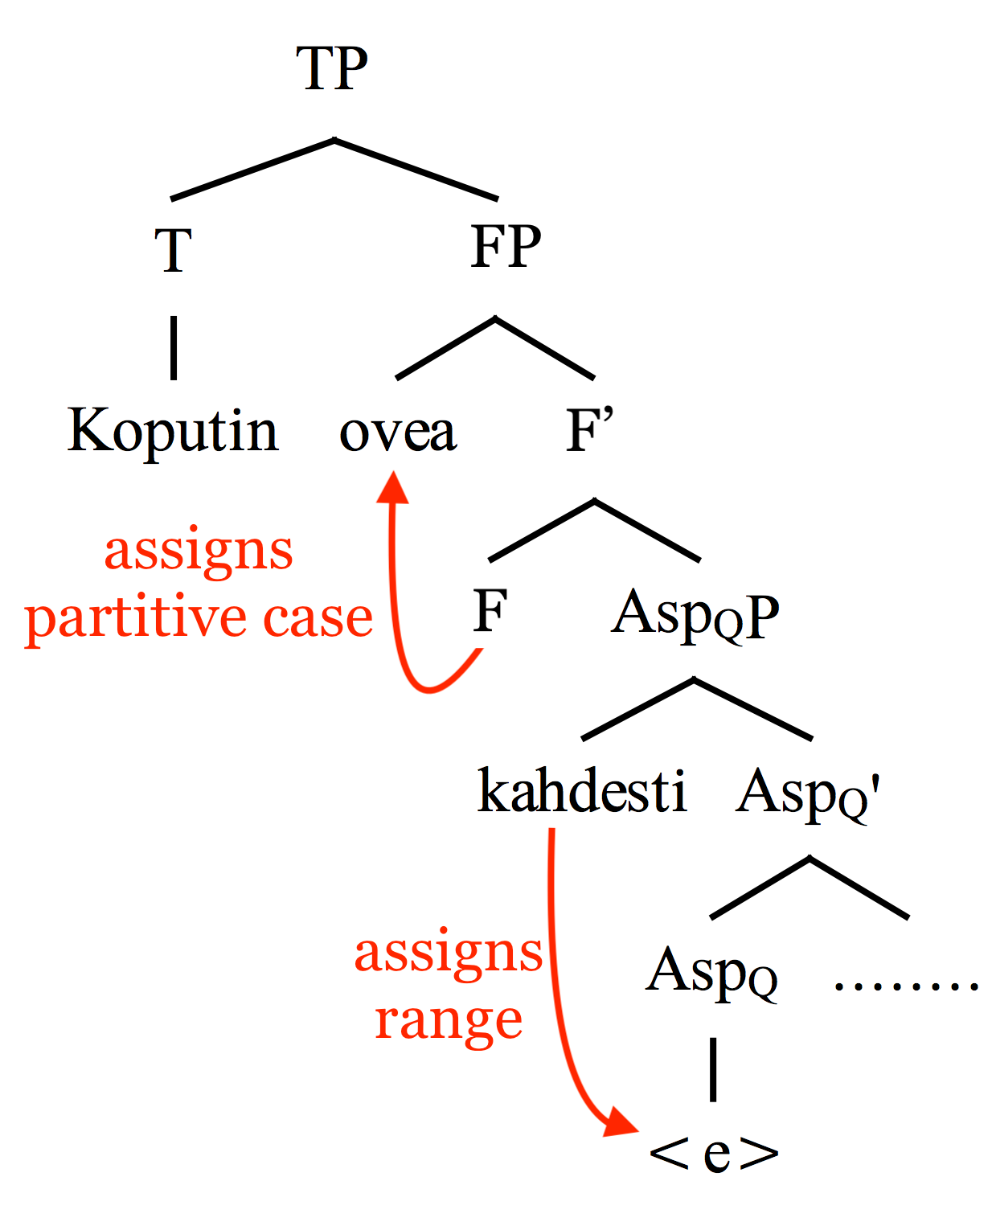
Empirical Evidence - Finnish
Koputin ovea kahdesti.
knocked.1st.SG door-PRT twice
“I knocked the door twice.”

Slide 21
Conclusions
A verbal classifier divides an event into countable sub-events, thereby licensing the presence of a numeral.
A numeral specifies the number of sub-events, thereby making the whole event quantity (telic).

Slide 22
References
Borer, Hagit. (2005a). In Name Only: Structuring Sense, Vol. 1. Oxford: Oxford University Press.
Borer, Hagit. (2005b). The Normal Course of Events: Structuring Sense, Vol. 2. Oxford: Oxford University Press.
Borer, Hagit. (2013). Taking Form: Structuring Sense, Vol. 3. Oxford: Oxford University Press.
Huang, James, Audrey Li, & Yafei Li (2009). The Syntax of Chinese. New York: Cambridge University Press.
Li, XuPing. (2013). Numeral Classifiers in Chinese: The Syntax-Semantics Interface. Berlin/Boston: Walter de Gruyter GmbH.
Ramchand, Gillian. (2008). Verb Meaning and the Lexicon: A First Phase Syntax. New York: Cambridge University Press.
Verkuyl, Henk J. (1972). On the Compositional Nature of the Aspect. Dordrecht: Reidel.
Zhang, N. N. (2017). The Syntax of Event‐Internal and Event‐External Verbal Classifiers. Studia Linguistica, 71(3), 266-300.

Slide 23
Thank you!

