Slide 1

New Purdue Travel Credit Card Procedures
Following are instructions for increasing your Purdue Travel Credit Card purchasing limit. Graduate students’ travel credit cards automatically reset to $0, so an increase must be requested for each trip.
This is completed using Concur, so your first step is to create your account in the app, which is found in OnePurdue.
Step two is to request a Purdue Travel Credit Card (see separate instructions).
Step three is to request approval for your trip (see separate instructions – the trip approval process is how you will know the credit card spending limit to request, and it is also how I will know to let the Business Office approve your credit card spending limit request).
Step four is the travel credit card limit increase explained here.
During your trip, please retain receipts as required (see separate policy documents).
After your trip, please email your receipts to me. I will use them to create your expense report and when it’s complete, you will submit it.

Slide 2
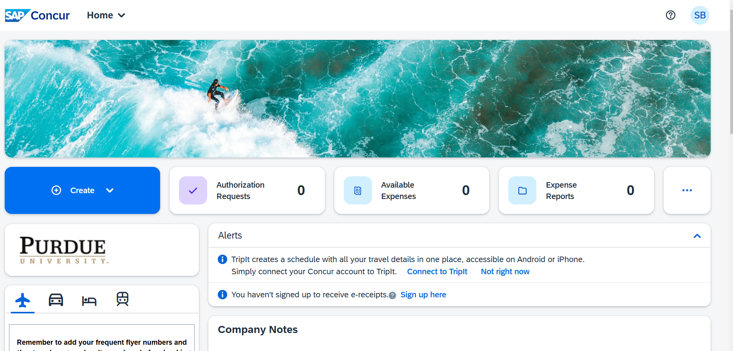

Slide 3
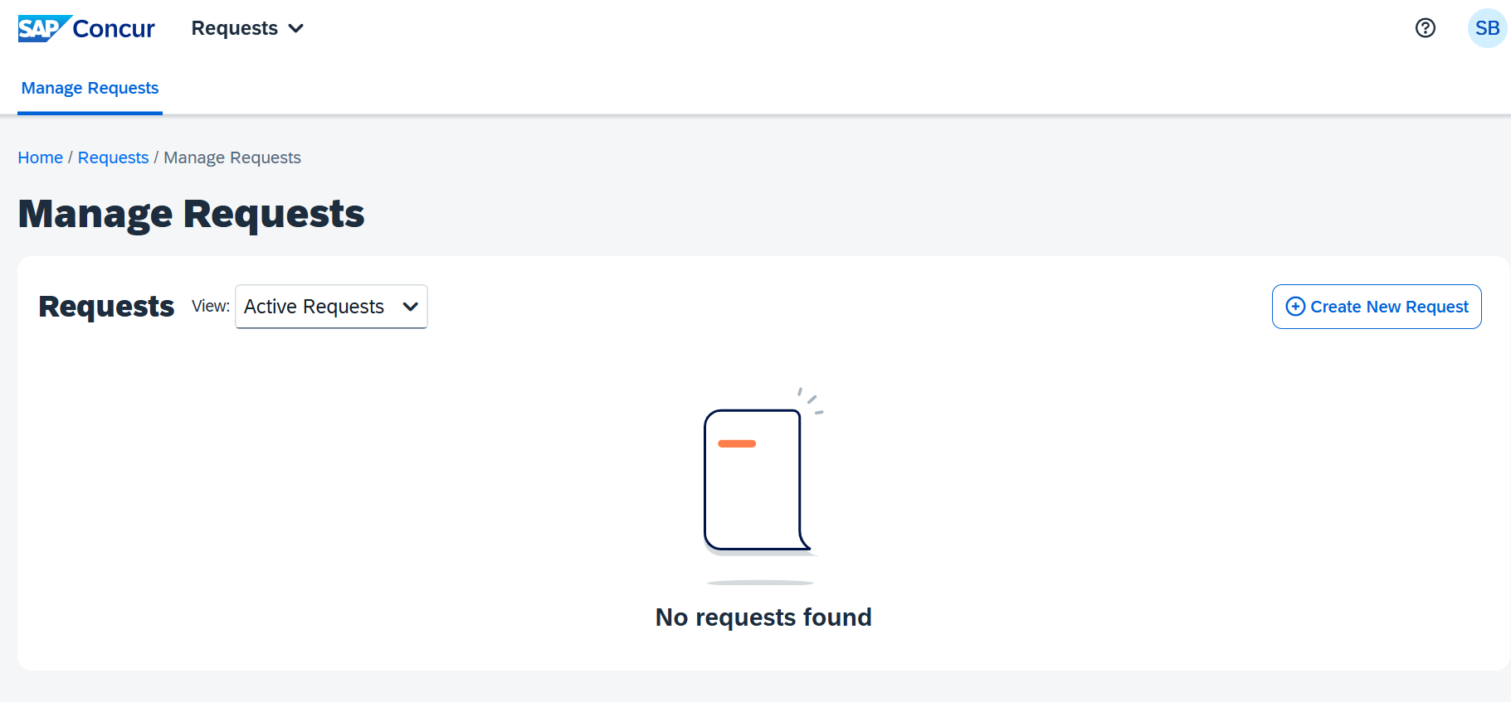

Slide 4
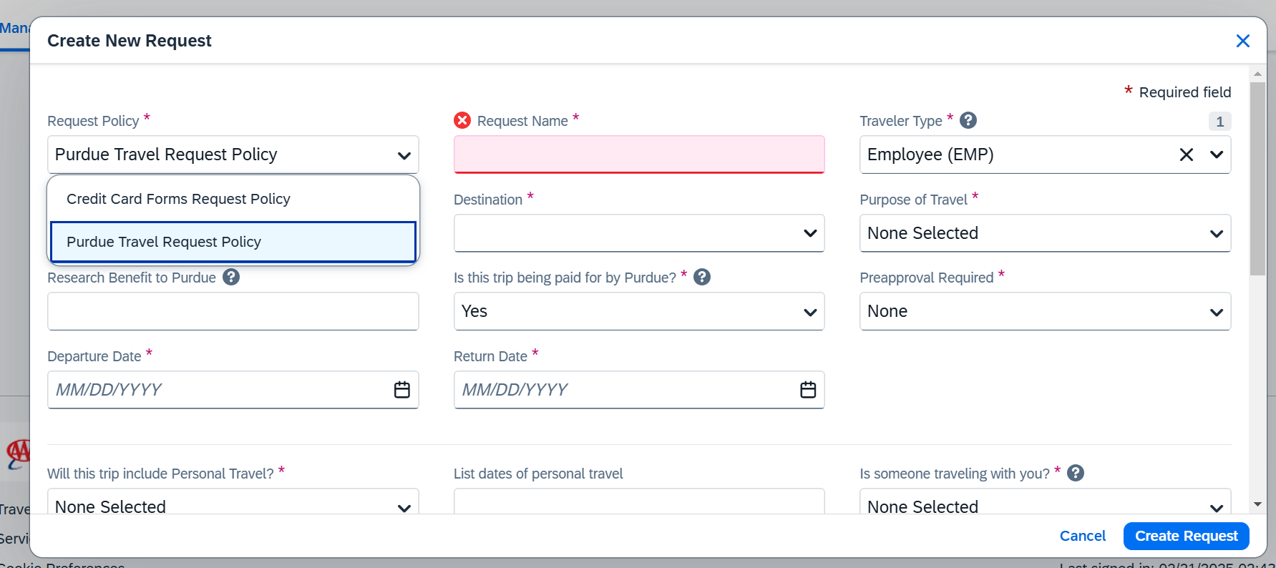

Slide 5
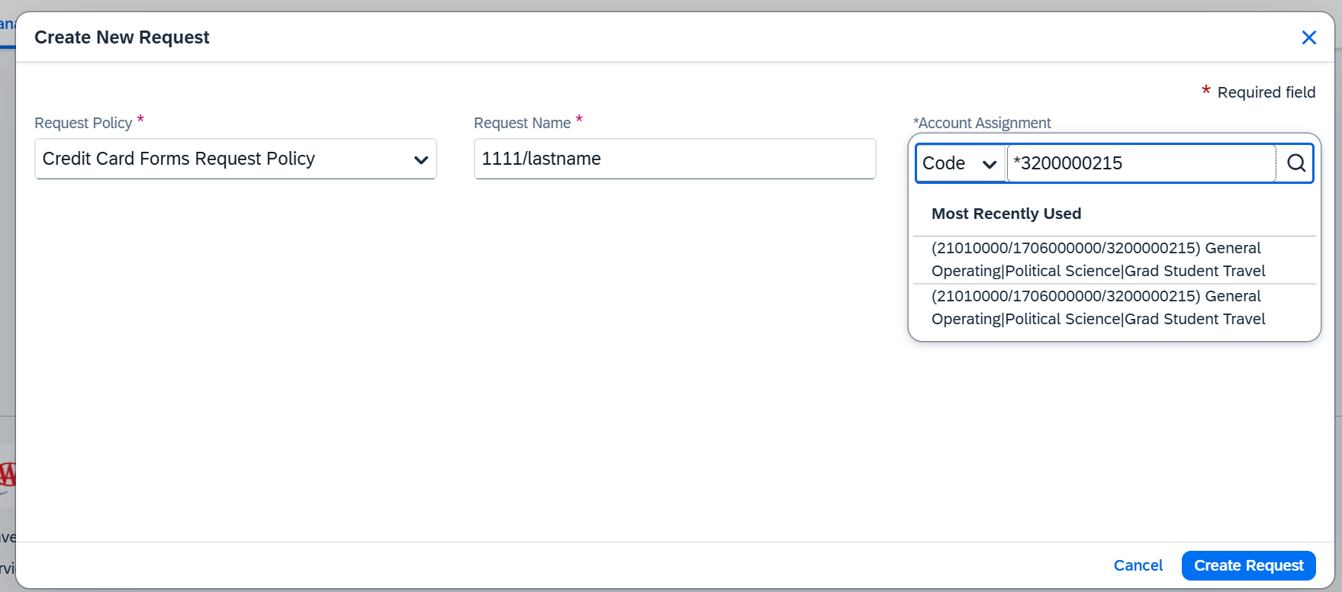
The last 4 digits of your Purdue Travel Credit Card, then your last name and first name
This account number is just a placeholder, it’s not final.

Slide 6
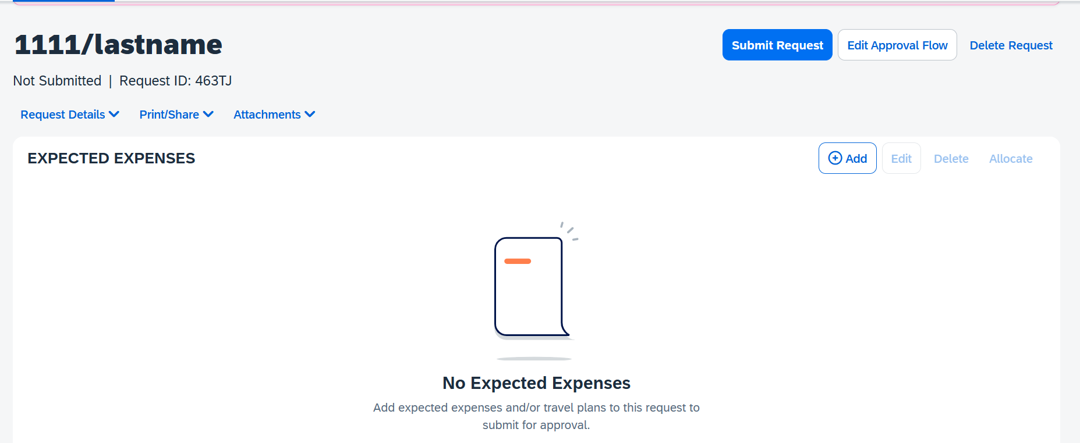

Slide 7
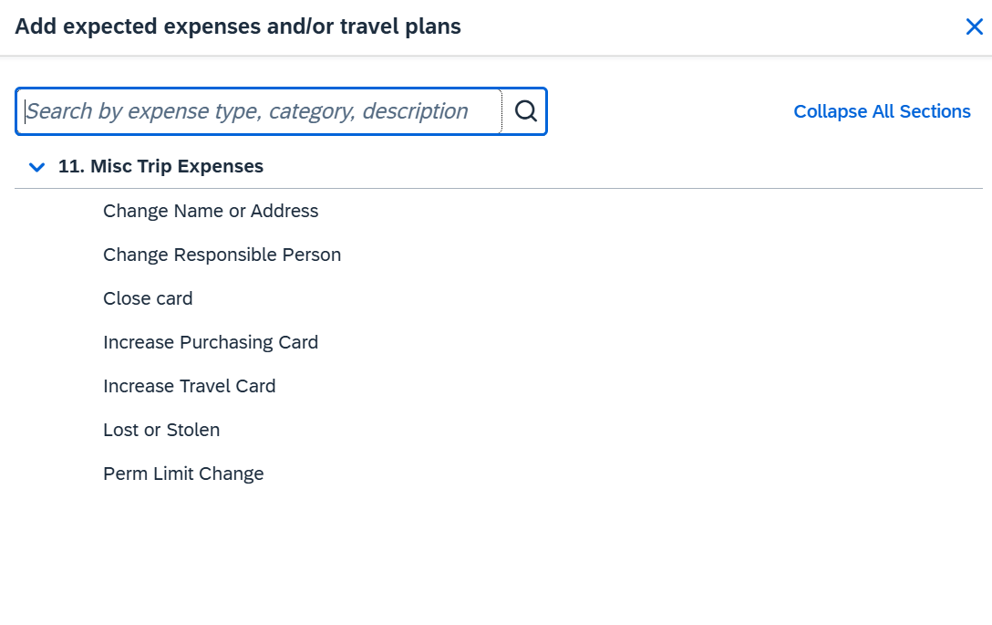

Slide 8
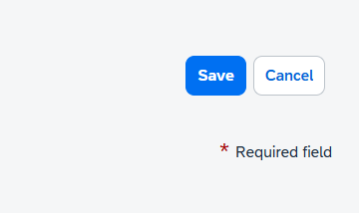
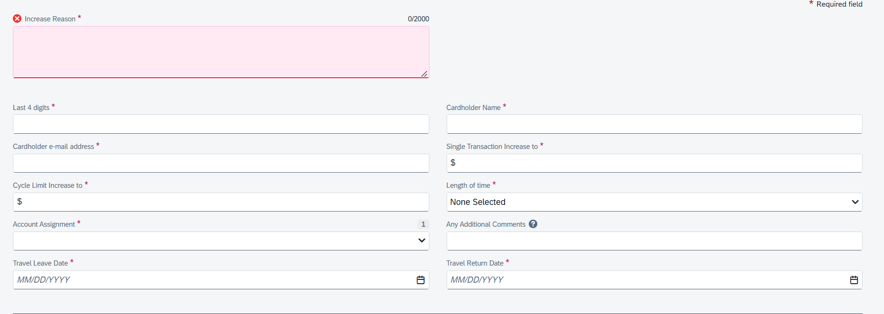
Save
City and Name of Conference
of your Purdue Travel Credit Card
1234
Last, First
xxx@purdue.edu
Your funding limit (verify w Stacy)
Your funding limit (verify w Stacy)
1 or 2 months (if that’s not long enough, you will need to make another request later)
*3200000215
Deposit for Registration, Airfare, Hotel, or Whole trip
04/02/2025
04/06/2025
The asterisk is needed in order to find the account

Slide 9
