Slide 1
Anthropology
2024 Summer Course information

Slide 2
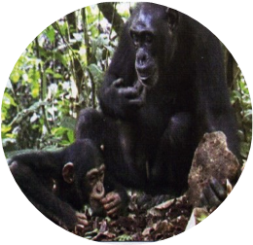
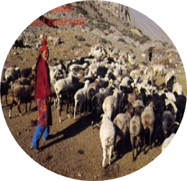
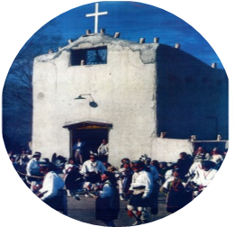
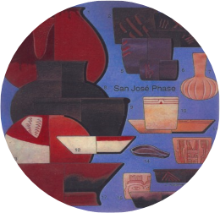
Introduction to Anthropology
ANTH 100
20XX
20XX
20XX
20XX
20XX
Month
Month
Month
Month
Month
This course provides an overview of the diverse and dynamic discipline of anthropology. You will learn about: What primate research tells about humans- Six million years of biological, technological, biotechnological, social and cultural evolution- Understanding human biological diversity- Early complex Societies- Religion, ritual, culture, and society-Households, families, and kinship in the past and modern world-The roots of cooperation, conflict, and morality-Applying anthropological knowledge to problem-solving.

Slide 3
ANTH 201: INTRODUCTION TO ARCHAEOLOGY AND WORLD PREHISTORY
SUMMER 2024
JUNE 10 - JULY 30
ASYNC/ONLINE
ARE YOU INTERESTED IN ARCHAEOLOGY?
THIS COURSE FULFILLS:
ANTH 201 introduces the ideas and practices behind archaeology and will discuss many famous archaeological sites. Students will learn about archaeological discoveries and how to conduct archaeological research.
University Core: Human Cultures (BSS)
CLA Core
Cornerstone Certificate
ANTH Major/Minor
Contact Cassie Apuzzo with questions: capuzzo@purdue.edu

Slide 4
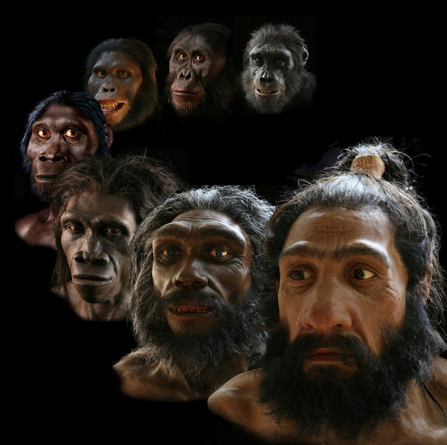
Anth 204: Introduction to Biological Anthropology and Human Evolution
What makes us human? Is it the use of language, culture, or the fact that we are bipedal? The purpose of this course is to learn evolutionary theory in order to gain a better understanding of the past, present and future of the human species.
Instructor: Keevil, Distance Learning, June 10 – August 2

Slide 5
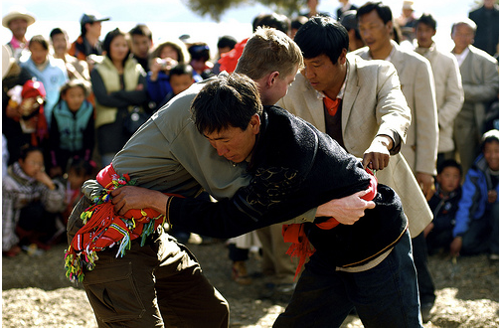
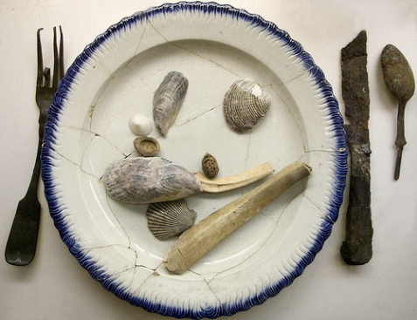
ANTH 205
Human Cultural Diversity
Using concepts and models of cultural anthropology, this course will survey the principal cultural types of the world and their distribution, and will undertake a detailed analysis of societies representative of each type.
Instructor Dates Room CRN
Martinez May 13-June 7 Distance Learning 11771 Eklund July 8-August 2 Distance Learning 12673
Fahey June 10 – August 2 Distance Learning 19545
Summer 2024
Department of Anthropology
Purdue University
Photo Source: AAA 2008 Contest Winners

Slide 6
ANTH 210:Technology & Culture
Summer 2024
June 10 – August 2 Instructor: Long
Distance Learning
May 13 – June 7 Instructor: Eklund
Distance Learning
Is AI a job-killer?
Can we geoengineer our
way out of climate change?
Why was there a space race?
Should life forms be patented?
Has social media changed us?
Why are people afraid of GMOs?
These are questions of fact but also values, beliefs, institutions, & culture.
This course examines the ways that science & technology shape our everyday lives & our understanding of the future. We consider a range of cases from the perspective of ancient, modern, “post-modern” & imagined social worlds.
— ALL ARE WELCOME —

Slide 7
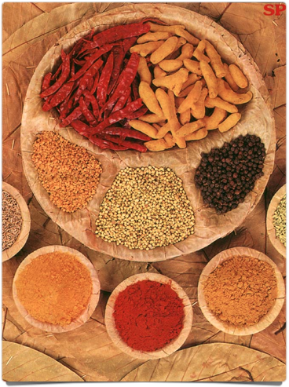
Anth. 212: Culture, Food, and Health
Summer 2024
Distance Learning
May 13 – June 7
Instructor: Dr. Wirtz
This course is designed to provide an introduction to the field of Nutritional Anthropology in which we will examine issues related to diet, health and illness from holistic anthropological perspectives.

Slide 8
ANTH 340 GLOBAL PERSPECTIVES ON HEALTH Wirtz |Distance learning| July 8 – August 2 Aulds |Distance learning| May 13 – June 7
This course examines health issues and risks faced by individuals around the world, but especially in resource poor geographical areas. We will explore in-depth the gendered, ethnic, cultural, and class dimensions that underlie the patterning of disease and illness worldwide.
.

Slide 9
Brazil Abroad 2024 Anth 418 Ethnographic Methods: Indigenous Rights, Conservation, Film, and Development
July 15-August 5, 2024
6 credits, Estimated cost 4,200
Join us in the Brazilian Amazon to learn from Indigenous leaders, Brazilian Professors, and guest lecturers as you immerse yourself into community life, visit local universities, and explore botanical gardens and museums.
Major topics covered include: rights and self-determination, Indigenous entrepreneurship, responsible global partnerships, inclusive conservation, activist filmmaking, community-based archaeology, oral history, media, sustainability and regional foodways
Places include Rio de Janeiro and A’Ukre village, Pará, Brazil
Honors options available, no prequisities
Interested? Contact: Laura Zanotti lzanotti@purdue.edu

Slide 12
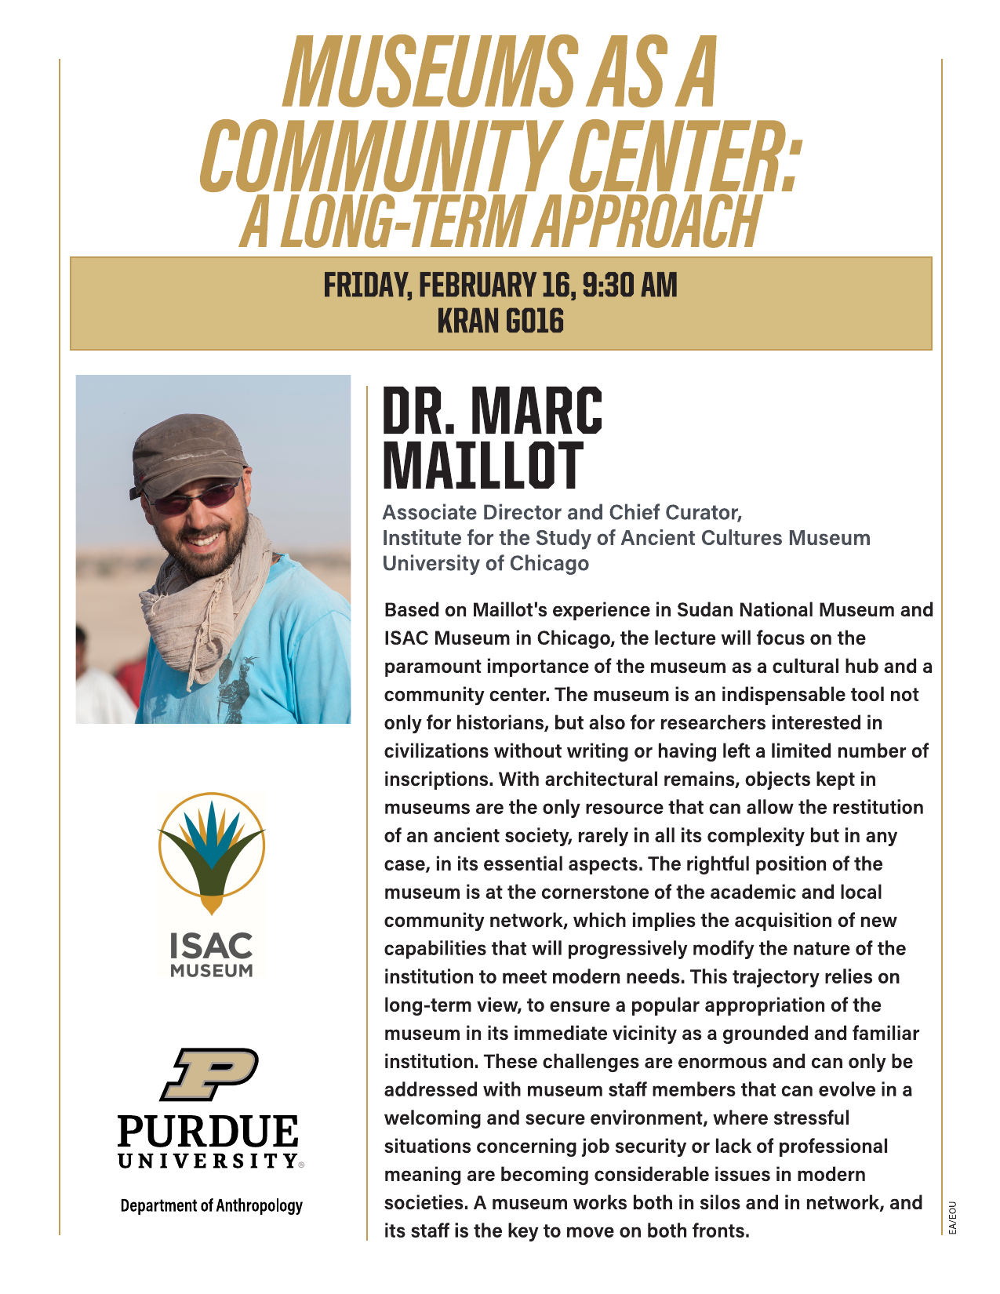

Slide 13
